Slide 1
Light-Emitting Diodes (LEDs)
For optical communication systems requiring bit rates less than approximately 100–200 Mb/s together with multimode fiber-coupled optical power in the tens of microwatts, semiconductor light-emitting diodes (LEDs) are usually the best light source choice.
These LEDs require
Less complex drive circuitry than laser diodes
No thermal or optical stabilization circuits are needed
They can be fabricated less expensively with higher yields.

Slide 2
LED Structures
To be useful in fiber transmission applications, an LED must have a high radiance output, a fast emission response time, and a high quantum efficiency.
Its radiance (or brightness) is a measure, in watts, of the optical power radiated into a unit solid angle per unit area of the emitting surface.
High radiances are necessary to couple sufficiently high optical power levels into a fiber.
The emission response time is the time delay between the application of a current pulse and the onset of optical emission.
This time delay is the factor limiting the bandwidth with which the source can be modulated directly by varying the injected current.
The quantum efficiency is related to the fraction of injected electron–hole pairs that recombine radiatively.

Slide 3
To achieve a high radiance and a high quantum efficiency, the LED structure must provide a means of confining the charge carriers and the stimulated optical emission to the active region of the pn junction where radiative recombination takes place.
Carrier confinement is used to achieve a high level of radiative recombination in the active region of the device, which yields a high quantum efficiency.
Optical confinement is of importance for preventing absorption of the emitted radiation by the material surrounding the pn junction.

Slide 4
LED DESIGNS
Two basic structures of LED are in use. These are (i) surface-emitting LED (SLED) and (ii) edge-emitting LED (ELED).
Configurations based on GaAs/ GaAlAs have been used in short-haul applications, whereas those based on InGaAsP/ InP have been employed in medium-range fiber links.
Relatively recently, a third device known as a super luminescent diode (SLD) has also been increasingly used in communications.

Slide 5
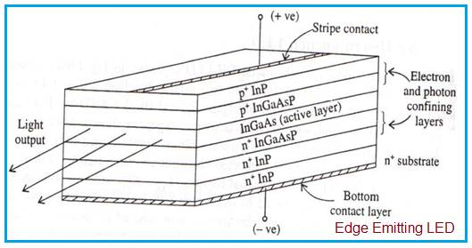
Edge Emitting LED
It is widely used in optical fiber communication system.
Here collimated light from LED is required to be fed into the fiber with high coupling efficiency. The figure depicts multilayer structure of InP based edge emitting LED.
It is used for long wavelength optical communication approx. between 1.33 to 1.55 µm.

Slide 6
Modern epitaxial growth techniques such as Molecular Beam Epitaxy (MBE), Metal-Organic Chemical Vapor Deposition (MOCVD) are used in order to design such complex LED structures.
The structure consists of five epitaxial layers.
Central active layer is made using InGaAs having narrow bandgap.
It is bounded by wide bandgap layers such as p+ InGaAsP and n+ InP cladding layers.
The positive contact is in the form of a stripe (the rest of the contact being isolated by the SiO2 layer).
These two cladding layers help in confining injected electrons and holes into the middle layer.
It also helps emitted photons to travel along LED axis as per optical properties.

Slide 7
Due to above, light is emitted from the edge of the LED. Hence it is known by the name edge emitting LED.
The rear-end facet is made reflecting while the front-end facet is coated with an antireflection coating, so that the laser action due to optical feedback is suppressed.
The self-absorption of radiation in the active layer is reduced because its thickness is made very small.
Much of the guided radiation propagates through the confining layers, which have a wider band gap. Therefore, they do not absorb this radiation.
The recombination radiation generated in the active region is guided by internal reflection at the heterojunctions and is brought out at the front-end facet of the diode.
An important effect of the optical guidance of emitted radiation is that the output beam has low divergence (typically ~30°) in the vertical direction.
This increases the efficiency of coupling the LED with the optical fiber.
Stripe geometry ELEDs based on InP/In GaAsP materials and with improved designs for coupling to single-mode fibers have also been made.
The optical power obtained from such a structure is 2 to 6 times smaller than that of a Surface emitting LED but more efficient coupling due to narrow band width.

Slide 8
Advantages of Edge Emitting LED
Following are the benefits or advantages of Edge Emitting LED: ➨It has superior beam collimation property which offers greater coupling efficiency with fiber optic cable compare to surface emitting LED. ➨It offers higher efficiency with low to high radiance. It fulfills high brightness LED requirements of the lighting industry. ➨It radiates less power to the air compare to surface emitting LED due to reabsorption and interfacial recombination. ➨It offers better modulation bandwidth and more directional emission pattern. ➨It offers 5-6 times more coupled power into NA (Numerical Aperture) of step/graded index fibers. This is due to small beam divergence. ➨It offers high data rates (> 20 Mbps) than surface emitting LED.

Slide 9
Disadvantages of Edge Emitting LED
Following are the drawbacks or disadvantages of Edge Emitting LED: ➨Its structure is complex. ➨It is difficult to design heat sink. ➨It is expensive compare to other LED types. ➨There are many issues to be handled during mechanical mounting and installation.

Slide 10
Surface Emitting LEDs
In the surface emitter, the plane of the active light-emitting region is oriented perpendicularly to the axis of the fiber.
In this configuration, a well is etched through the substrate of the device, into which a fiber is then cemented in order to accept the emitted light.
The circular active area in practical surface emitters is nominally 50 mm in diameter and up to 2.5 mm thick.
The emission pattern is essentially isotropic with a 120° half-power beam width.

Slide 11
To achieve carrier and optical confinement, LED configurations such as homojunctions and single and double heterojunctions have been widely investigated.
The most effective of these structures is the configuration.
This is referred to as a double-heterostructure (or heterojunction) device because of the two different alloy layers on each side of the active region.

Slide 12
The surface emitting LED structure consists of thin central active layer of p type GaAs.
This central layer is bounded by n-type AlGaAs/n⁺-type GaAs at the top side.
This central layer is bounded by p-type AlGaAs/p⁺-type GaAs at the bottom side.
The extreme top n⁺ type GaAs and bottom p⁺-type GaAs layers are used to provide low resistive ohmic contacts only.
The external optical fiber is connected by etching the top layers and by shielding with epoxy resin.
When refractive indices of both p-type and n-type materials are same, light is free to come out from all the sides of the semiconductor device due to no confinement.
However only active region near the surface will emit the significant amount of light while absorbing from the other parts. Hence it is known as surface emitting LED

Slide 13
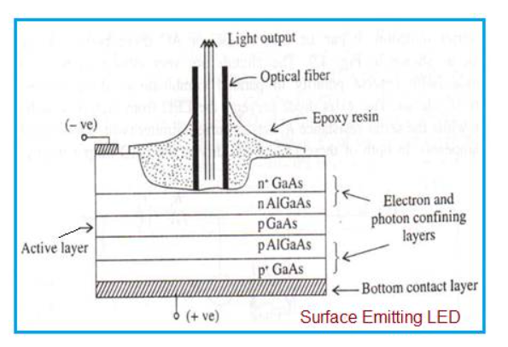

Slide 14
Output radiation is originated from central thin layer i.e. p-type GaAs layer.
Maximum optical power Pc is coupled with the optical fiber is expressed as follows.
Pc = π * (1-R) * A* Rs * (NA)² Where, R = Reflection loss at fiber surface A = Fiber cross section area Rs = Radiance amount from source NA = Numerical Aperture

Slide 15
Benefits of Surface Emitting LED
Following are the benefits or advantages of Surface Emitting LED: ➨Optical coupling coefficient of LED with external fiber system is relatively higher. Hence this LED offers high optical coupling efficiency. ➨Optical loss (due to internal absorption) is very low. This is because of carrier recombination near its top heterojunction. ➨InP/InGaAsP based LED is used for long wavelength applications. ➨It offers higher efficiency with low to high radiance. ➨The top n-GaAs contact layer ensures low thermal resistance and contact resistance. This allows high current densities and high radiation intensity. ➨The internal absorption in the device is very low due to larger bandgap confining layers. Moreover reflection coefficient at the back crystal face is high which gives good forward radiance.

Slide 16
Drawbacks of Surface Emitting LED
Following are the drawbacks or disadvantages of Surface Emitting LED: ➨The surface emitting LED can transmit data rate less than 20 Mbps than edge emitting LED. ➨It contains short optical link with large NA (Numerical Aperture).

Slide 17
This isotropic pattern from such a surface emitter is called a Lambertian pattern.
In this pattern, the source is equally bright when viewed from any direction, but the power diminishes as cos q, where q is the angle between the viewing direction and the normal to the surface (this is because the projected area one sees decreases as cos q).
Thus, the power is down to 50 percent of its peak when q = 60°, so that the total half-power beam width is 120°

Slide 18

Quantum Efficiency and LED Power
An excess of electrons and holes in p- and n-type material, respectively (referred to as minority carriers) is created in a semiconductor light source by carrier injection at the device contacts.
The excess densities of electrons n and holes p are equal, since the injected carriers are formed and recombine in pairs in accordance with the requirement for charge neutrality in the crystal.
When carrier injection stops, the carrier density returns to the equilibrium value. In general, the excess carrier density decays exponentially with time according to the relation
where n₀ is the initial injected excess electron density and the time constant t is the carrier lifetime.
This lifetime is one of the most important operating parameters of an electro-optic device.
Its value can range from milliseconds to fractions of a nanosecond depending on material composition and device defects.

Slide 19

The excess carriers can recombine either radiatively or nonradiatively. In radiative recombination a photon of energy which is approximately equal to the bandgap energy, is emitted.
Nonradiative recombination effects include optical absorption in the active region (self-absorption), carrier recombination at the heterostructure interfaces, and the Auger process in which the energy released during an electron–hole recombination is transferred to another carrier in the form of kinetic energy.

Slide 20

When there is a constant current fl ow into an LED, an equilibrium condition is established.
That is, the excess density of electrons n and holes p is equal since the injected carriers are created and recombined in pairs such that charge neutrality is maintained within the device.
The total rate at which carriers are generated is the sum of the externally supplied and the thermally generated rates. The externally supplied rate is given by J/qd, where J is the current density in A/cm² , q is the electron charge, and d is the thickness of the recombination region.
The thermal generation rate is given by n/τ. Hence, the rate equation for carrier recombination in an LED can be written as
-----------🡪1

Slide 21


The equilibrium condition is found by setting Eq. (1) equal to zero, yielding
This relationship gives the steady-state electron density in the active region when a constant current is flowing through it.
The internal quantum efficiency in the active region is the fraction of the electron–hole pairs that recombine radiatively.
If the radiative recombination rate is R_{r} and the nonradiative recombination rate is R_{nr}, then the internal quantum efficiency hint is the ratio of the radiative recombination rate to the total recombination rate:
----🡪3
-----🡪2

Slide 22
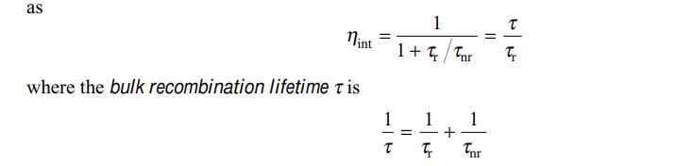
For exponential decay of excess carriers, the radiative recombination lifetime is τ_{r} = n/R_{r} and the nonradiative recombination lifetime is τ_{nr} = n/R_{nr}.
Thus the internal quantum efficiency can be expressed

Slide 23
In general, t_{r} and t_{nr} are comparable for direct-bandgap semiconductors, such as GaAlAs and InGaAsP.
This also means that R_{r} and R_{nr} are similar in magnitude, so that the internal quantum efficiency is about 50 percent for simple homojunction LEDs.
However, LEDs having double-heterojunction structures can have quantum efficiencies of 60–80 percent.
This high efficiency is achieved because the thin active regions of these devices mitigate the self-absorption effects, which reduces the nonradiative recombination rate.
If the current injected into the LED is I, then the total number of recombination per second is
------🡪5

Slide 24


Sub eqn 5 in 3 then yields.
Noting that Rr is the total number of photons generated per second and that each photon has an energy hϒ, then the optical power generated internally to the LED is

Slide 25
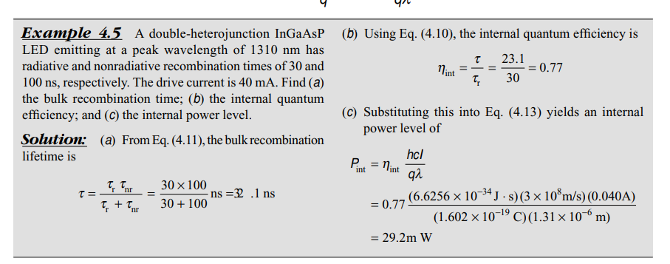

Slide 26

Not all internally generated photons will exit the device.
To find the emitted power, one needs to consider the
This is defined as the ratio of the photons emitted from the LED to the number of internally generated photons.
To find the external quantum efficiency, we need to take into account reflection effects at the surface of the LED.
As shown in Fig ,at the interface of a material boundary only that fraction of light falling within a cone defined by the critical angle Φ_{c} will cross the interface.
we know that Φ_{c} = sin^{–1} (n₂/n₁). Here, n₁ is the refractive index of the semiconductor material and n₂ is the refractive index of the outside material, which nominally is air with n₂ = 1.0.

Slide 27
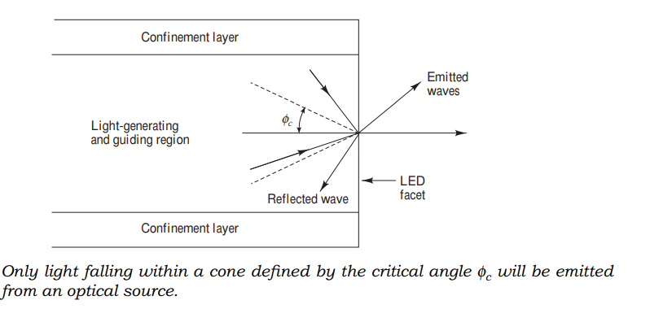

Slide 28


The external quantum efficiency can then be calculated from the expression
where T(Φ) is the Fresnel transmission coefficient or Fresnel transmissivity. This factor depends on the incidence angle Φ but, for simplicity, we can use the expression for normal incidence, which is

Slide 29
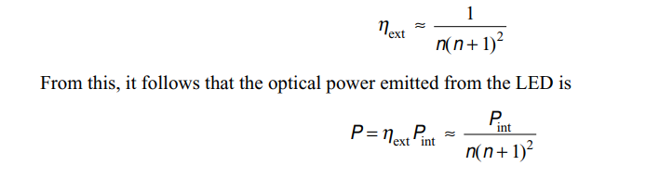
Assuming the outside medium is air and letting n₁ = n, we have T(0) = 4n/(n + 1)² . The external quantum efficiency is then approximately given by

Slide 30
